Slide 1
Topic-based Auto-highlighting and Grouping with LLMs for Review Speed
Pretty Slides
https://docs.google.com/presentation/d/1YXdOVcDevuZHQQJC15d0ScUAIx4hpbG5_WUBDO9SoMg/edit?usp=sharing
By: Allen Jue and Temitayo Awosemo

Slide 2
Topic-based Auto-highlighting and Grouping with LLMs for Review Speed
By: Allen Jue and Temitayo Awosemo

Slide 3
Each group will have 5 minutes to present and 1 minute for setup. This time limit will be strictly enforced – groups should set up during the question session of the group before them. To enable this, unplug the video cable from your laptop before answering questions.
Test (and debug) your laptop video projection before presentations begin. Time spent fiddling with display settings will count against your presentation time.
Structure your presentation like a pyramid — begin with a one-sentence statement of your research result. This will get everyone on the same page. Then, offer a short description of what you did and why you did it. Then, explain things in detail.
This presentation is short enough that you can write out everything you want to say long-hand (in your notes and not on the slide). Do this! This will allow you to convey information efficiently and effectively. Read through it enough times so that you have it basically memorized, but not so memorized that you get flustered if you skip a word or someone asks a question.
Demonstrate your system if you created one (via recorded videos) and tell a story about how the user would use it.
Know your audience! You can expect that everyone in the class knows everything you learned in class. So, you don't need to re-introduce the whole field of HCI. A sentence or two to situate your work in the field is good, but spend the rest of the time telling us what you did.
When presenting, stand near your slides. And look at the audience.
When people walk away from your presentation they should understand: your project’s goals (and why they matter) and your project’s results (and their implications). The audience should be convinced of the importance, novelty and validity of your research.

Slide 4
Contents
Background
Prototype Demo
Experiment Overview
Metrics we captured (why?)
How we crafted questions for paper
How we grade responses in a objective way
Results pt. 1
Qualitative + Quantitative
Results pt. 2
Qualitative + Quantitative
Limitations
Further Work
Conclusion

Slide 5
Research Result
Automatic topic grouping does not seem to suggest faster review times, but it may encourage students to make deeper connections in their notes.

Slide 6
Reading can be hard.

Slide 7
Prior Work
Active highlighting benefits understanding and knowledge retention¹
Take time to take your own notes²
Non-linear note-taking is beneficial³
Constrained highlighting improves reading comprehension⁴

Slide 8
Existing solutions try to improve reading comprehension, but what about review time?

Slide 9
Our solution
We designed a highlighting tool that allows users to group their highlighted notes together by making queries to GPT-3.5
Hypothesis: quicker review times when using the tool with comparable comprehension

Slide 10
Demo

Slide 11
Experiment Overview
Passages chosen:
“The Men of Brewster Place” (Short Passage)
“Beyond Being There” (Long Passage)
Phase 1
Participants divided into two groups: Group A and Group B
Group A read the short passage with the tool and the long passage without it
Group B read the passages with conditions switched
Phase 2
Participants were allowed to review their highlights on both passages
Participants were evaluated to test comprehension
Notes:
Design choices, why unlimited time, why crossover
We chose two passages to evaluate our tool. The Men of Brewster Place and Beyond Being There. <Why we chose to do both long and short> <Why we chose to do a crossover study>

Slide 12
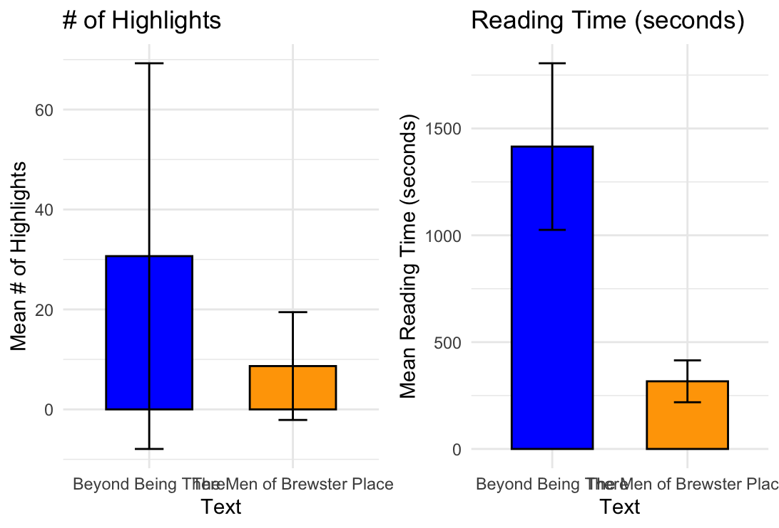
Phase 1 Results

Slide 13
Topic-based Auto-highlighting and Grouping with LLMs for Review Speed
Pretty Slides
https://docs.google.com/presentation/d/1YXdOVcDevuZHQQJC15d0ScUAIx4hpbG5_WUBDO9SoMg/edit?usp=sharing
By: Allen Jue and Temitayo Awosemo

Slide 14
Qualitative Results
Quotes

Slide 15
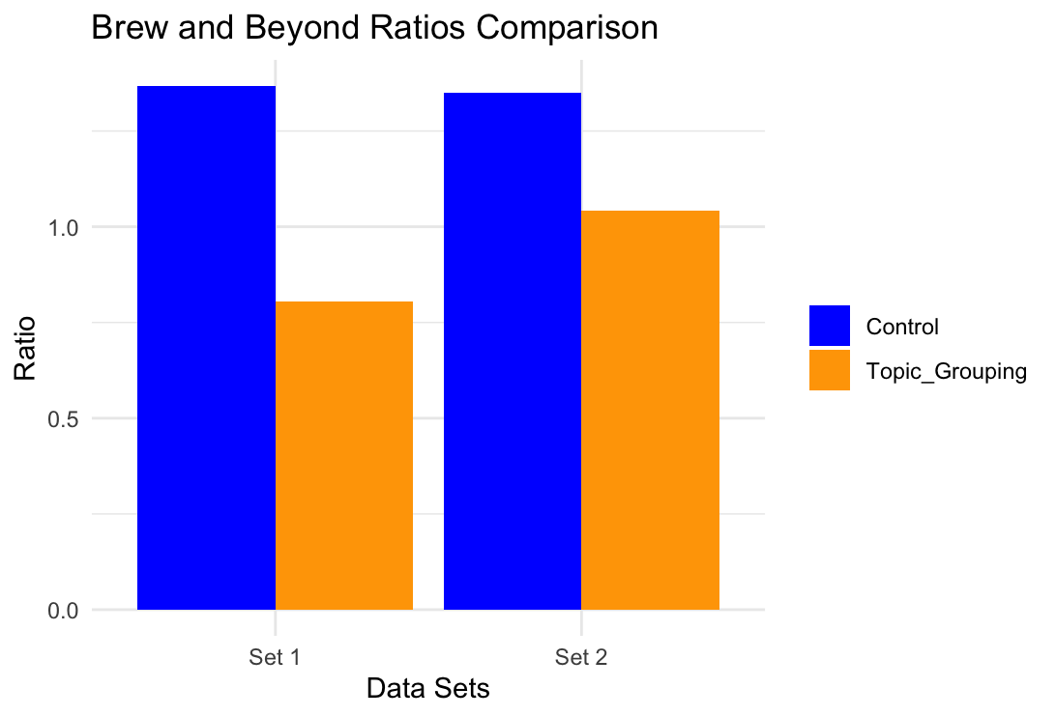
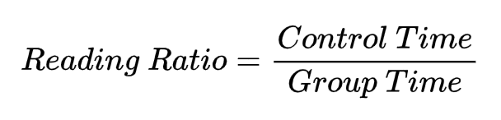
Phase 2 Results
Not statistically significant!
For scores, the topic grouping scored higher in both
86% vs. 100%
73% vs. 80%
Short Passage
Long Passage

Slide 16
Qualitative Results
Quotes

Slide 17
Limitations
Small # participants due to 2 phase approach and time (n = 4)

Slide 18
Further Work
Faced end of semester time constraint -> More testing
Reduced review time more useful in dense, long readings, so testing even larger body of texts
More participants
Longer time period between initial reading and evaluation
Introduce user defined groups and see its effects on review
Compare static and dynamic grouping
Formalize and measure the cognitive load of traditional reviewing

Slide 19
Conclusion

Slide 20
References
[1] Dunlosky, J., Rawson, K. A., Marsh, E. J., Nathan, M. J., & Willingham, D. T. (2013). Improving students’ learning with effective learning techniques. Psychological Science in the Public Interest, 14(1), 4–58. https://doi.org/10.1177/1529100612453266
[2] Friedman, M. C. (2014). Notes on note-taking: Review of research and insights for students and instructors. Harvard Initiative for Learning and Teaching, 1-34.
[3] Piolat, A., Olive, T., & Kellogg, R. T. (2004). Cognitive effort during note taking. In Applied Cognitive Psychology (Vol. 19, Issue 3, pp. 291–312). Wiley. https://doi.org/10.1002/acp.1086
[4] Joshi, N., & Vogel, D. (2024). Constrained Highlighting in a Document Reader can Improve Reading Comprehension. In Proceedings of the CHI Conference on Human Factors in Computing Systems (pp. 1–10). CHI ’24: CHI Conference on Human Factors in Computing Systems. ACM. https://doi.org/10.1145/3613904.3642314

